Slide 1
ONLYCLONE
Your AI studio runs
your entire creator agency.
Creation, production, audience workflows and operations in one creator-owned desktop workspace.
FOUNDING CREATOR RELEASE / 31 OCTOBER 2026
Notes:
Prepared from the current OnlyClone website and the owner's supplied founding offer. Product release-stage labels remain subject to the website disclosures.

Slide 2
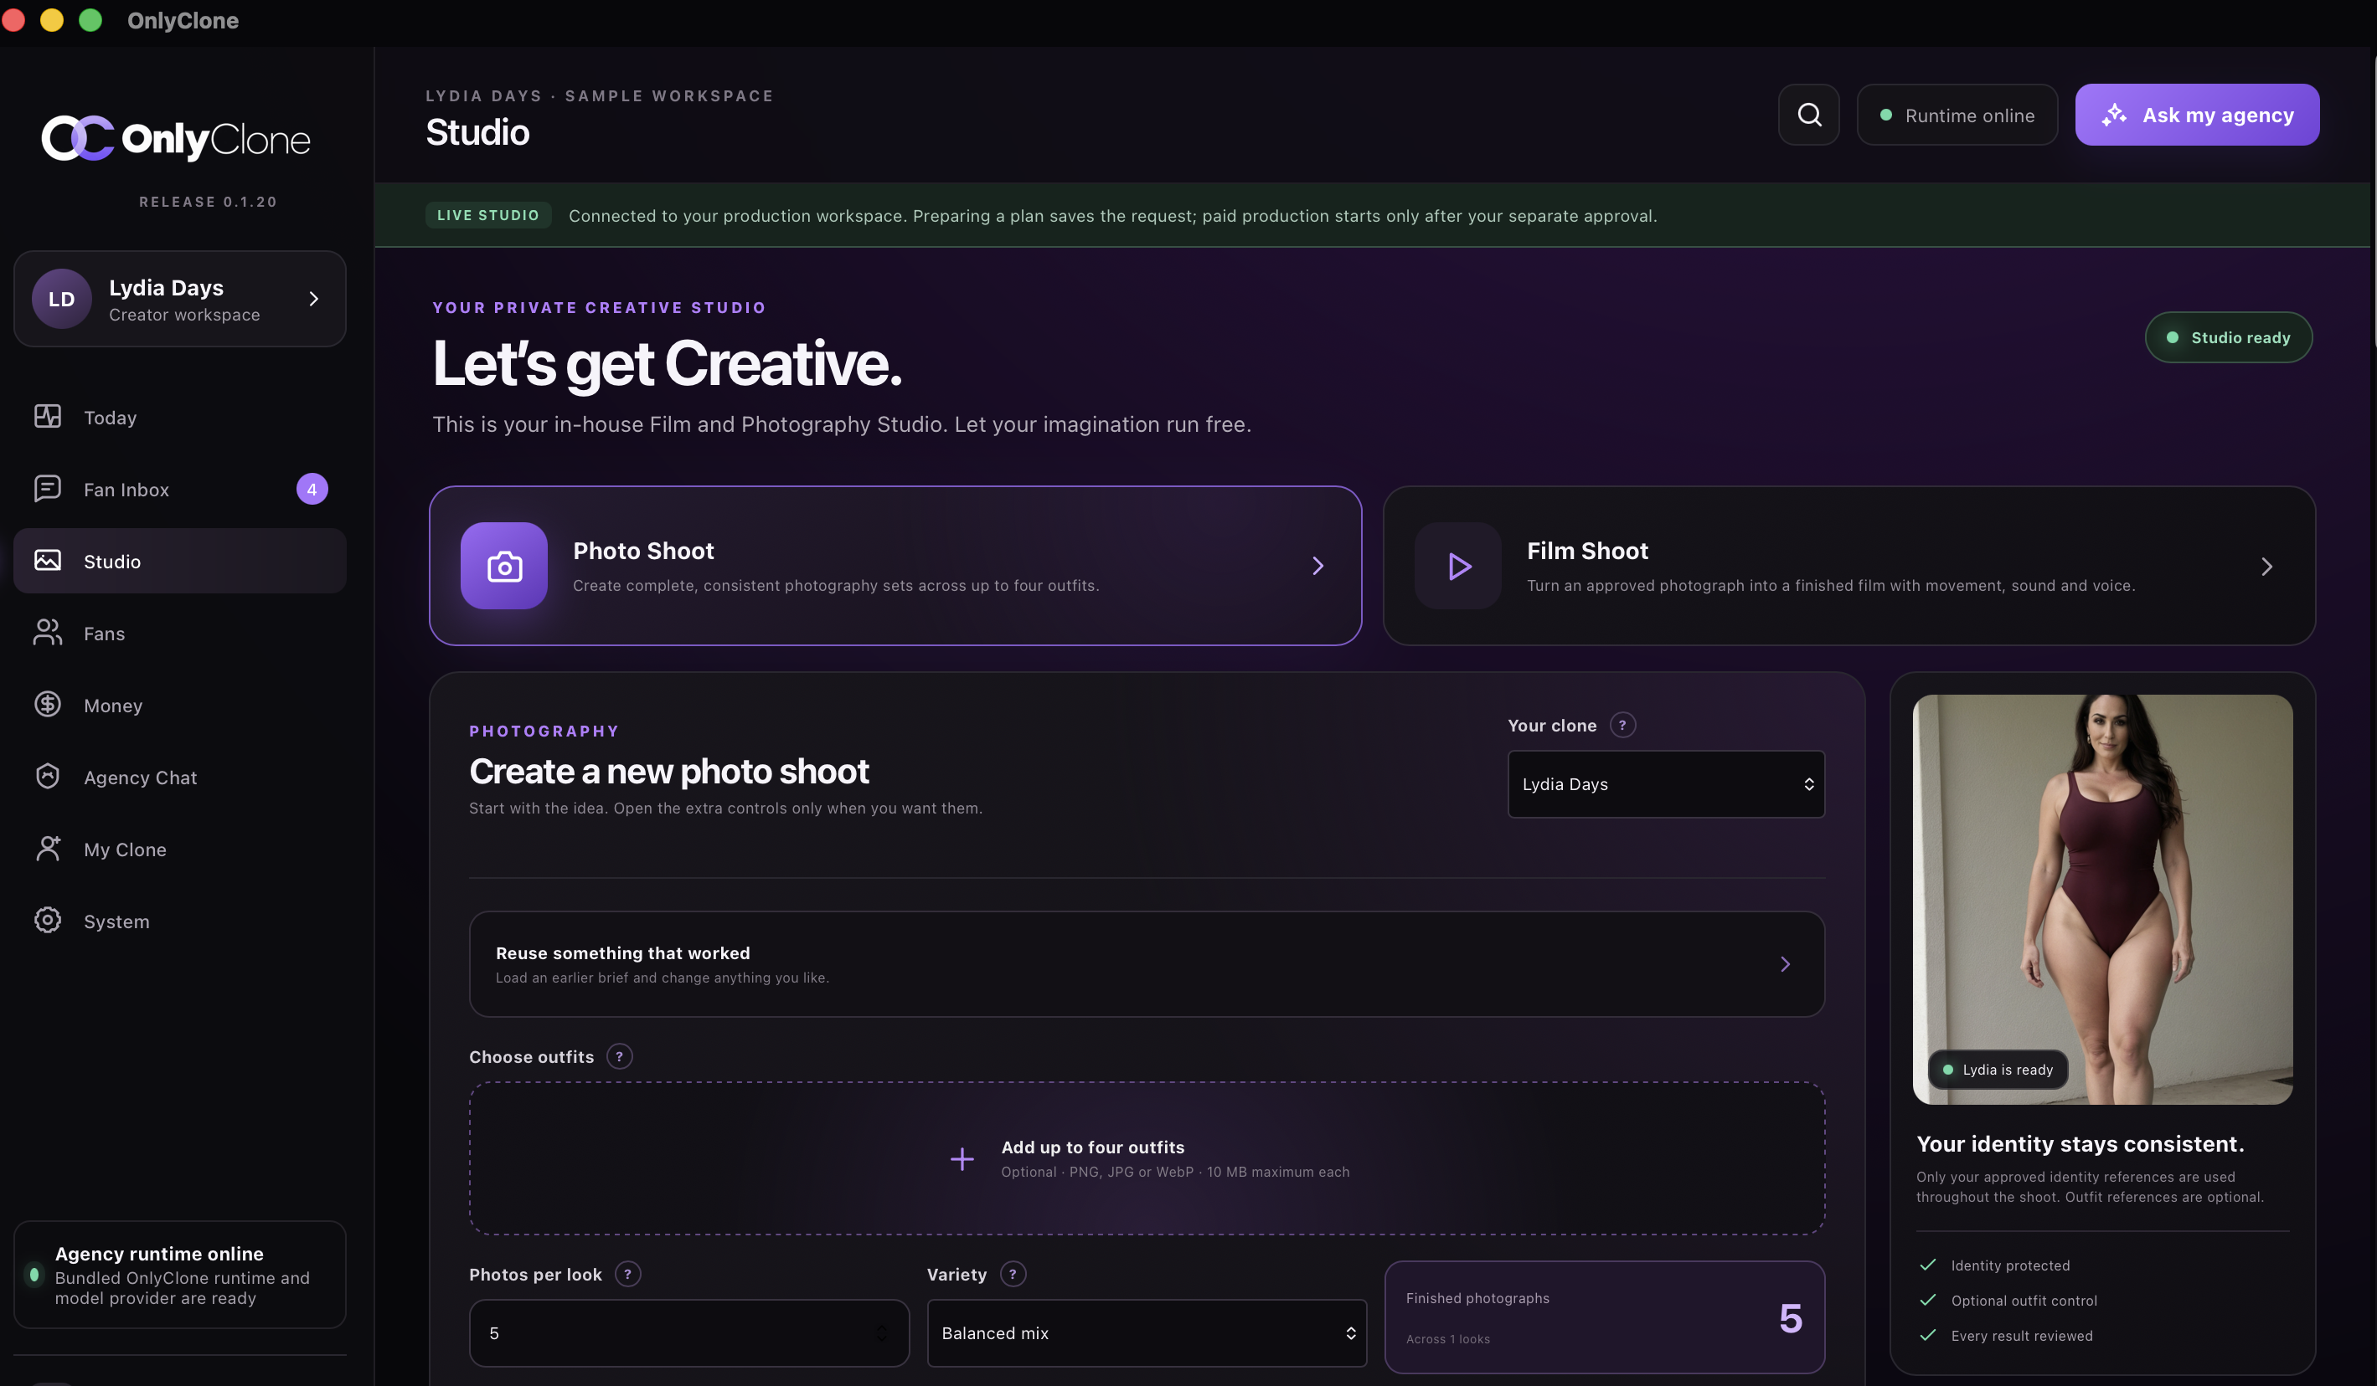
ONLYCLONE / FOUNDING CREATOR RELEASE
ONE CONNECTED WORKSPACE
Specialist agents. One agency view.
OnlyClone coordinates identity, studio production, social workflows, conversations, money signals and operational review.
ONLYCLONE.APP · OCTOBER 2026
Notes:
Screenshot supplied in the current OnlyClone site source. Social and conversation workflows are supervised beta; money is an MVP integration; other workflow maturity is described on the website.

Slide 3
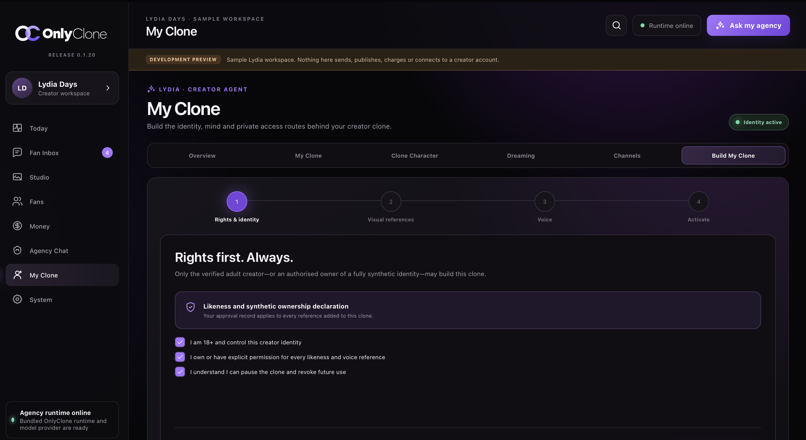
ONLYCLONE / FOUNDING CREATOR RELEASE
IDENTITY AND PRODUCTION
A consistent identity, ready for the studio.
The core workflow prepares an approved identity for repeatable photo and film production. External actions remain behind review or owner approval where required.
01 IDENTITY
Approved references
Consistent character
Clear boundaries
ONLYCLONE.APP · OCTOBER 2026
Notes:
No claim of autonomous production or external publishing. Identity use requires authority and consent for supplied references.

Slide 4
ONLYCLONE / FOUNDING CREATOR RELEASE
FOUNDING PACKAGES
Choose the support that fits.
One-time founding prices. Package allocations show total places, not live availability.
STARTER
OPERATOR
FOUNDERS CIRCLE
£80
£300
£500
1 identity
20% referral share
15 places
Multiple identities
30% referral share
10 places
Private group + 1:1 founder access (up to 30 min)
£100 generation/token credit
40% referral share · 5 places
ONLYCLONE.APP · OCTOBER 2026
Notes:
Package prices, place allocations, referral percentages and included credit follow the owner's supplied instructions. Referral programme tracking and payouts are not live on the website at time of publication.

Slide 5
ONLYCLONE / FOUNDING CREATOR RELEASE
PRICE AND REFERRAL EXAMPLES
The arithmetic, in the open.
Annual price comparison uses the monthly reference prices supplied for this calculation, multiplied by 12.
PACKAGE
MONTHLY × 12
PRICE DIFFERENCE
PER REFERRAL
12-MONTH EXAMPLE
Starter
£49.99 × 12 = £599.88
£519.88 vs £80 once
20% = £16 per £80 sale
£192/year*
Operator
£149.99 × 12 = £1,799.88
£1,499.88 vs £300 once
30% = £90 per £300 sale
£1,080/year*
Founders Circle
£199 × 12 = £2,388
£1,888 vs £500 once
40% = £200 per £500 sale
£2,400/year*
*Referral examples assume one completed, paid same-tier referral per month for 12 months. Illustrations only, not a revenue promise. Monthly comparison is not a live competitor quote or like-for-like total-cost guarantee. Referral tracking, attribution and payouts still need implementation.
ONLYCLONE.APP · OCTOBER 2026
Notes:
Calculations: annual comparison = supplied monthly reference × 12 minus one-time founding price. Referral example = package price × assigned referral rate, then ×12 for one same-tier referral per month. No guarantee of sales or earnings.

